Slide 1
CNNs
Marcus Rüb
Hahn-Schickard Villingen-Schwenningen
Marcus.rueb@hahn-schickard.de

Slide 2
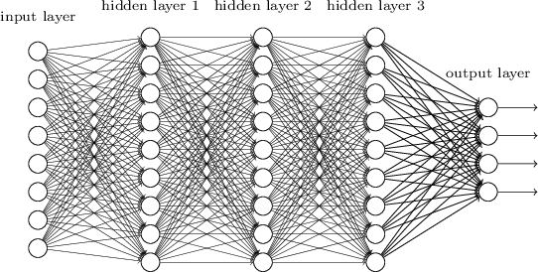
Fully Connected Neural Network
Width
Depth

Slide 3

Problems using FC Layers on Images
How to process a tiny image with FC layers
5 weights
5
5
3
3 neuron layer

Slide 4
Problems using FC Layers on Images
How to process a tiny image with FC layers
25 weights
For the whole 5×5 image on 1 channel
5
5
3
3 neuron layer

Slide 5
Problems using FC Layers on Images
How to process a tiny image with FC layers
75 weights
For the whole 5×5 image on the 3 channel
5
5
3
3 neuron layer

Slide 6
Problems using FC Layers on Images
How to process a tiny image with FC layers
75 weights
For the whole 5×5 image on the three channels per neuron
75 weights
5
75 weights
5
3
3 neuron layer

Slide 7
Problems using FC Layers on Images
How to process a normal image with FC layers
1000
1000
3
3 neuron layer

Slide 8
Problems using FC Layers on Images
How to process a normal image with FC layers
1000
3 𝑏𝑖𝑙𝑙𝑖𝑜𝑛 weights
IMPRACTICAL
1000
3
1000 neuron layer

Slide 9
Why not simply more FC Layers?
We cannot make networks arbitrarily complex
Why not just go deeper and get better?
No structure!!
It is just brute force!
Optimization becomes hard
Performance plateaus / drops!

Slide 10
Better Way than FC ?
We want to restrict the degrees of freedom
We want a layer with structure
Weight sharing → using the same weights for different parts of the image

Slide 11
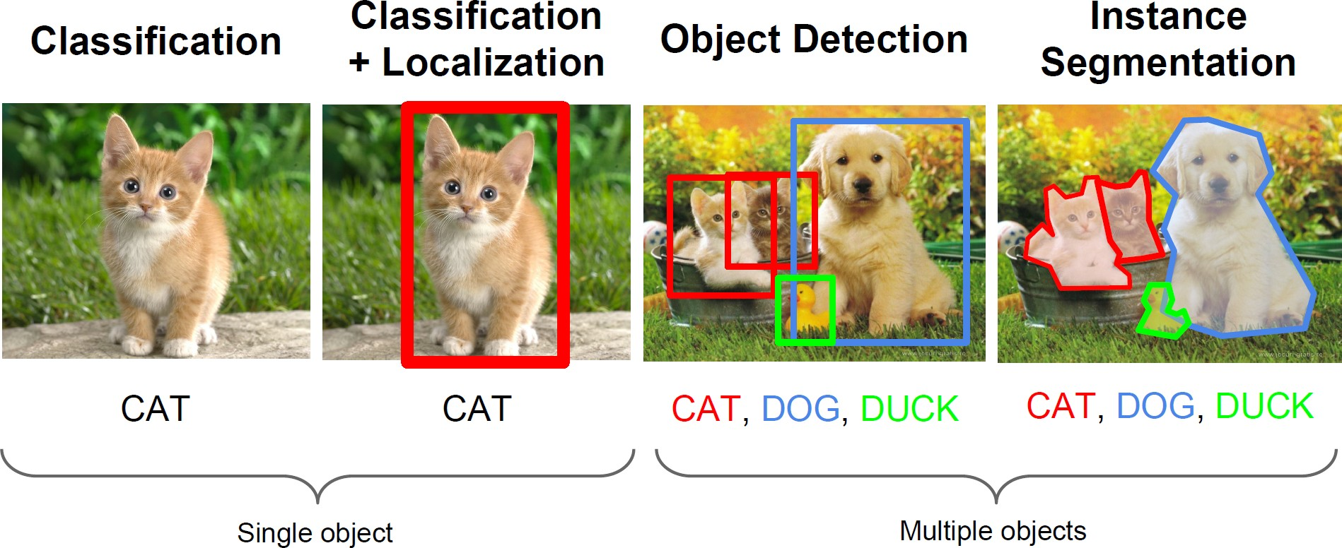
Using CNNs in Computer Vision
[Li et al., CS231n Course Slides] Lecture 12: Detection and Segmentation

Slide 12
Convolutions

Slide 13
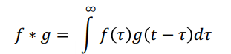
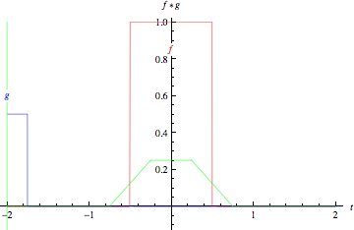
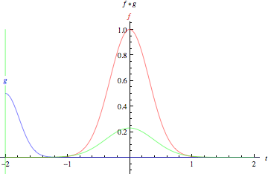
What are Convolutions?
𝑓 = red
𝑔 = blue
𝑓 ∗ 𝑔 = green
Convolution of two box functions Convolution of two Gaussians Application of a filter to a function
— The ‘smaller’ one is typically called the filter kernel

Slide 14


What are Convolutions?
Discrete case: box filter
𝑓
𝑔
4 | 3 | 2 | -5 | 3 | 5 | 2 | 5 | 5 | 6
1/3 | 1/3 | 1/3
‘Slide’ filter kernel from left to right; at each position, compute a single value in the output data

Slide 15
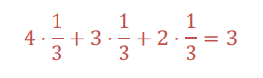
What are Convolutions?
Discrete case: box filter
𝑓
𝑔
𝑓 ∗ 𝑔
4 | 3 | 2 | -5 | 3 | 5 | 2 | 5 | 5 | 6
1/3 | 1/3 | 1/3
 | 3

Slide 16


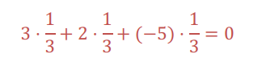
What are Convolutions?
Discrete case: box filter
𝑓
𝑔
𝑓 ∗ 𝑔
4 | 3 | 2 | -5 | 3 | 5 | 2 | 5 | 5 | 6
1/3 | 1/3 | 1/3
 | 3 | 0

Slide 17
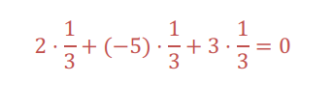
What are Convolutions?
Discrete case: box filter
𝑓
𝑔
𝑓 ∗ 𝑔
4 | 3 | 2 | -5 | 3 | 5 | 2 | 5 | 5 | 6
1/3 | 1/3 | 1/3
 | 3 | 0 | 0

Slide 18
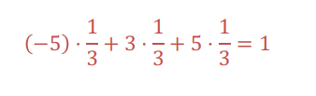
What are Convolutions?
Discrete case: box filter
𝑓
𝑔
𝑓 ∗ 𝑔
4 | 3 | 2 | -5 | 3 | 5 | 2 | 5 | 5 | 6
1/3 | 1/3 | 1/3
 | 3 | 0 | 0 | 1

Slide 19

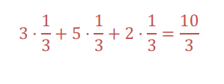
What are Convolutions?
Discrete case: box filter
𝑓
𝑔
𝑓 ∗ 𝑔
4 | 3 | 2 | -5 | 3 | 5 | 2 | 5 | 5 | 6
1/3 | 1/3 | 1/3
 | 3 | 0 | 0 | 1 | 10/3

Slide 20
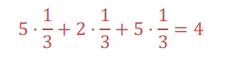
What are Convolutions?
Discrete case: box filter
𝑓
𝑔
𝑓 ∗ 𝑔
4 | 3 | 2 | -5 | 3 | 5 | 2 | 5 | 5 | 6
1/3 | 1/3 | 1/3
 | 3 | 0 | 0 | 1 | 10/3 | 4

Slide 21
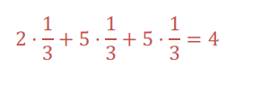
What are Convolutions?
Discrete case: box filter
𝑓
𝑔
𝑓 ∗ 𝑔
4 | 3 | 2 | -5 | 3 | 5 | 2 | 5 | 5 | 6
1/3 | 1/3 | 1/3
 | 3 | 0 | 0 | 1 | 10/3 | 4 | 4

Slide 22
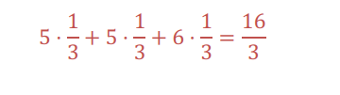
What are Convolutions?
Discrete case: box filter
𝑓
𝑔
𝑓 ∗ 𝑔
4 | 3 | 2 | -5 | 3 | 5 | 2 | 5 | 5 | 6
1/3 | 1/3 | 1/3
 | 3 | 0 | 0 | 1 | 10/3 | 4 | 4 | 16/3

Slide 23
What are Convolutions?
Discrete case: box filter
4 | 3 | 2 | -5 | 3 | 5 | 2 | 5 | 5 | 6
1/3 | 1/3 | 1/3
?? | 3 | 0 | 0 | 1 | 10/3 | 4 | 4 | 16/3 | ??
What to do at boundaries?

Slide 24
What are Convolutions?
Discrete case: box filter
4 | 3 | 2 | -5 | 3 | 5 | 2 | 5 | 5 | 6
1/3 | 1/3 | 1/3
?? | 3 | 0 | 0 | 1 | 10/3 | 4 | 4 | 16/3 | ??
What to do at boundaries?
Option 1: Shrink
3 | 0 | 0 | 1 | 10/3 | 4 | 4 | 16/3

Slide 25
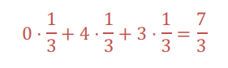
What are Convolutions?
Discrete case: box filter
0 | 4 | 3 | 2 | -5 | 3 | 5 | 2 | 5 | 5 | 6 | 0
1/3 | 1/3 | 1/3
?? | 3 | 0 | 0 | 1 | 10/3 | 4 | 4 | 16/3 | ??
What to do at boundaries?
Option 2: Pad (often 0’s)
7/3 | 3 | 0 | 0 | 1 | 10/3 | 4 | 4 | 16/3 | 11/3

Slide 26





Convolutions on Images
-5 | 3 | 2 | -5 | 3
4 | 3 | 2 | 1 | -3
1 | 0 | 3 | 3 | 5
-2 | 0 | 1 | 4 | 4
5 | 6 | 7 | 9 | -1
Image 5×5
Output 3×3
6
Kernel 3×3
0 | -1 | 0
-1 | 5 | -1
0 | -1 | 0
5 ⋅ 3 + −1 ⋅ 3 + −1 ⋅ 2 + −1 ⋅ 0 + −1 ⋅ 4
= 15 − 9 = 6

Slide 27



Convolutions on Images
-5 | 3 | 2 | -5 | 3
4 | 3 | 2 | 1 | -3
1 | 0 | 3 | 3 | 5
-2 | 0 | 1 | 4 | 4
5 | 6 | 7 | 9 | -1
Image 5×5
Output 3×3
6 | 1
Kernel 3×3
0 | -1 | 0
-1 | 5 | -1
0 | -1 | 0
5 ⋅ 2 + −1 ⋅ 2 + −1 ⋅ 1 + −1 ⋅ 3 + −1 ⋅ 3
= 10 − 9 = 1

Slide 28


Convolutions on Images
-5 | 3 | 2 | -5 | 3
4 | 3 | 2 | 1 | -3
1 | 0 | 3 | 3 | 5
-2 | 0 | 1 | 4 | 4
5 | 6 | 7 | 9 | -1
Image 5×5
Output 3×3
6 | 1 | 8
Kernel 3×3
0 | -1 | 0
-1 | 5 | -1
0 | -1 | 0
5 ⋅ 1 + −1 ⋅ −5 + −1 ⋅ −3 + −1 ⋅ 3
+ −1 ⋅ 2
= 5 + 3 = 8

Slide 29



Convolutions on Images
-5 | 3 | 2 | -5 | 3
4 | 3 | 2 | 1 | -3
1 | 0 | 3 | 3 | 5
-2 | 0 | 1 | 4 | 4
5 | 6 | 7 | 9 | -1
Image 5×5
Output 3×3
6 | 1 | 8
-7
Kernel 3×3
0 | -1 | 0
-1 | 5 | -1
0 | -1 | 0
5 ⋅ 0 + −1 ⋅ 3 + −1 ⋅ 0 + −1 ⋅ 1 + −1 ⋅ 3
= 0 − 7 = −7

Slide 30



Convolutions on Images
-5 | 3 | 2 | -5 | 3
4 | 3 | 2 | 1 | -3
1 | 0 | 3 | 3 | 5
-2 | 0 | 1 | 4 | 4
5 | 6 | 7 | 9 | -1
Image 5×5
Output 3×3
6 | 1 | 8
-7 | 9
Kernel 3×3
0 | -1 | 0
-1 | 5 | -1
0 | -1 | 0
5 ⋅ 3 + −1 ⋅ 2 + −1 ⋅ 3 + −1 ⋅ 1 + −1 ⋅ 0
= 15 − 6 = 9

Slide 31


Convolutions on Images
-5 | 3 | 2 | -5 | 3
4 | 3 | 2 | 1 | -3
1 | 0 | 3 | 3 | 5
-2 | 0 | 1 | 4 | 4
5 | 6 | 7 | 9 | -1
Image 5×5
Output 3×3
6 | 1 | 8
-7 | 9 | 2
Kernel 3×3
0 | -1 | 0
-1 | 5 | -1
0 | -1 | 0
5 ⋅ 3 + −1 ⋅ 1 + −1 ⋅ 5 + −1 ⋅ 4 + −1 ⋅ 3
= 15 − 13 = 2

Slide 32



Convolutions on Images
-5 | 3 | 2 | -5 | 3
4 | 3 | 2 | 1 | -3
1 | 0 | 3 | 3 | 5
-2 | 0 | 1 | 4 | 4
5 | 6 | 7 | 9 | -1
Image 5×5
Output 3×3
6 | 1 | 8
-7 | 9 | 2
-5
Kernel 3×3
0 | -1 | 0
-1 | 5 | -1
0 | -1 | 0
5 ⋅ 0 + −1 ⋅ 0 + −1 ⋅ 1 + −1 ⋅ 6
+ −1 ⋅ −2
= −5

Slide 33



Convolutions on Images
-5 | 3 | 2 | -5 | 3
4 | 3 | 2 | 1 | -3
1 | 0 | 3 | 3 | 5
-2 | 0 | 1 | 4 | 4
5 | 6 | 7 | 9 | -1
Image 5×5
Output 3×3
6 | 1 | 8
-7 | 9 | 2
-5 | -9
Kernel 3×3
0 | -1 | 0
-1 | 5 | -1
0 | -1 | 0
5 ⋅ 1 + −1 ⋅ 3 + −1 ⋅ 4 + −1 ⋅ 7 + −1 ⋅ 0
= 5 − 14 = −9

Slide 34


Convolutions on Images
-5 | 3 | 2 | -5 | 3
4 | 3 | 2 | 1 | -3
1 | 0 | 3 | 3 | 5
-2 | 0 | 1 | 4 | 4
5 | 6 | 7 | 9 | -1
Image 5×5
Output 3×3
6 | 1 | 8
-7 | 9 | 2
-5 | -9 | 3
Kernel 3×3
0 | -1 | 0
-1 | 5 | -1
0 | -1 | 0
5 ⋅ 4 + −1 ⋅ 3 + −1 ⋅ 4 + −1 ⋅ 9 + −1 ⋅ 1
= 20 − 17 = 3

Slide 35
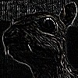
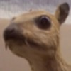


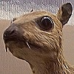

Image Filters
Each kernel gives us a different image filter
Edge detection
Box mean
Input
−1 −1 −1
₁ 1 1 1
−1 8 −1
−1 −1 −1
₉ 1 1 1
1 1 1
Sharpen
0 −1 0
Gaussian blur
1
1 2 1
−1 5 −1
0 −1 0
4 2
16 ²
1 2 1

Slide 36






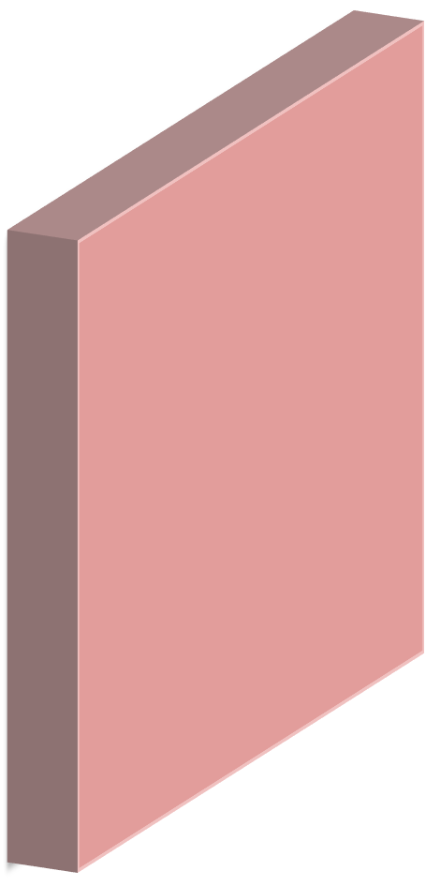



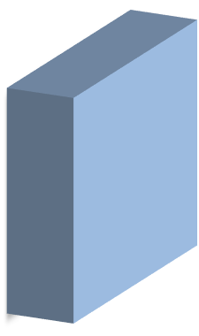
Convolutions on RGB Images
width
height depth
Depth dimension *must* match;
i.e., filter extends the full depth of the input
image 32×32×3
filter 5×5×3
Convolve filter with image i.e., ‘slide’ over it and:
apply filter at each location
dot products
32
5
5
3
32
Images have depth: e.g. RGB -> 3 channels
3

Slide 37



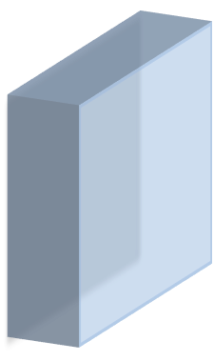








Convolutions on RGB Images
32×32×3 image (pixels 𝑿)
5×5×3 filter (weights vector 𝒘)
1 number at a time:
equal to dot product between
filter weights 𝒘 and 𝒙_{𝒊} − 𝑡ℎ chunk of
32
5
the image. Here: 5 ⋅ 5 ⋅ 3 = 75-dim dot product + bias
𝑧#
5
3
𝑧 _{i} = 𝒘^{t} 𝒙 _{i} + 𝑏
32
5×5×3 ×1
(5×5×3)×1
1
3
37

Slide 38



Convolutions on RGB Images
Activation map
32×32×3 image
(also feature map)
5×5×3 filter
28
32
5
Convolve
5
3
Slide over all spatial locations 𝑥 _{i}
and compute all output 𝑧 _{i} ; w/o padding, there are 28×28 locations
28
32
1
3
38

Slide 39
Convolution Layer
39

Slide 40

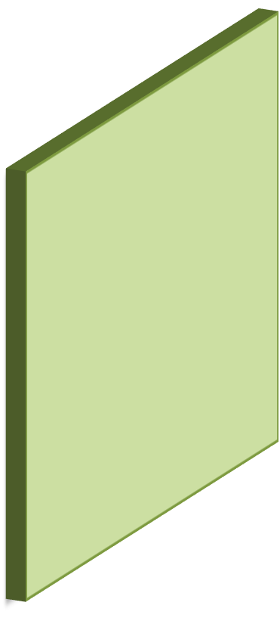
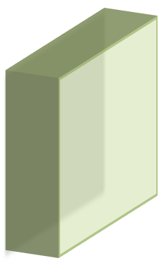
Convolution Layer
32×32×3 image
Activation maps
5×5×3 filter
28
32
5
Convolve
5
3
Let’s apply a different filter with different weights!
28
32
1 ₁
3
40

Slide 41
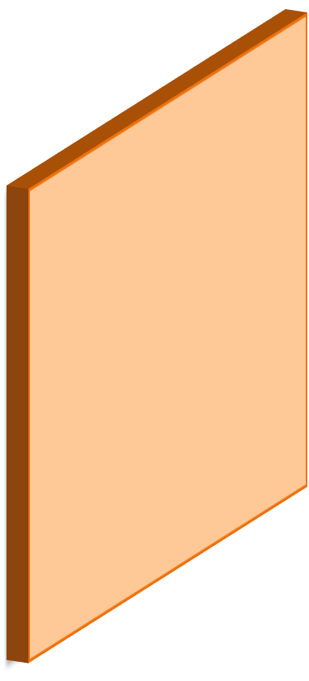
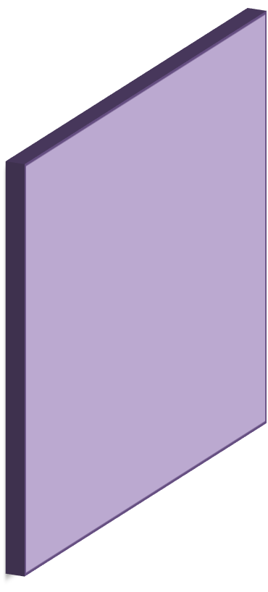

Convolution Layer
Convolution “Layer”
Activation maps
32×32×3 image
32
28
Convolve
Let’s apply **five** filters, each with different weights!
28
32
5
3
41

Slide 42
Convolution Layer
A basic layer is defined by
Filter width and height (depth is implicitly given)
Number of different filter banks (#weight sets)
Each filter captures a different image characteristic
42

Slide 43
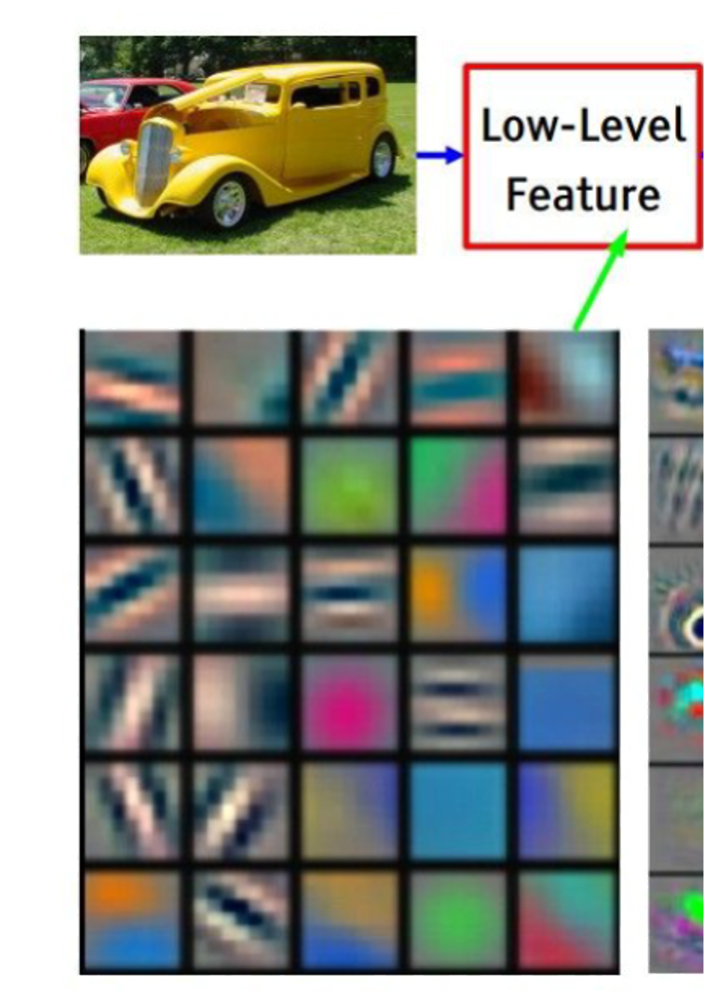
Different Filters
Each filter captures different image characteristics:
Horizontal edges
Vertical edges
Circles
Squares
– …
[Zeiler & Fergus, ECCV’14] Visualizing and Understanding Convolutional Networks
43

Slide 44
Dimensions of a Convolution Layer
44

Slide 45
Convolution Layers: Dimensions
1
Input: Filter: Output:
7×7
3×3
5×5
Image 7×7
45

Slide 46
Convolution Layers: Dimensions
2
Input: Filter: Output:
7×7
3×3
5×5
Image 7×7
46

Slide 47
Convolution Layers: Dimensions
3
Input: Filter: Output:
7×7
3×3
5×5
Image 7×7
47

Slide 48
Convolution Layers: Dimensions
4
Input: Filter: Output:
7×7
3×3
5×5
Image 7×7
48

Slide 49
Convolution Layers: Dimensions
5
Input: Filter: Output:
7×7
3×3
5×5
Image 7×7
49

Slide 50
Convolution Layers: Stride
With a stride of 1
Input: Filter: Stride: Output:
7×7
3×3
1
5×5
Image 7×7
Stride of 𝑆: apply filter every 𝑆-th spatial location;
i.e. subsample the image
50

Slide 51
Convolution Layers: Stride
With a stride of 2
Input: Filter: Stride: Output:
7×7
3×3
2
3×3
Image 7×7
51

Slide 52
Convolution Layers: Stride
With a stride of 2
Input: Filter: Stride: Output:
7×7
3×3
2
3×3
Image 7×7
52

Slide 53
Convolution Layers: Stride
With a stride of 2
Input: Filter: Stride: Output:
7×7
3×3
2
3×3
Image 7×7
53

Slide 54
Convolution Layers: Stride
With a stride of 3
Input: Filter: Stride: Output:
7×7
3×3
3
? × ?
Image 7×7
54

Slide 55
Convolution Layers: Stride
With a stride of 3
Input: Filter: Stride: Output:
7×7
3×3
3
? × ?
Image 7×7
55

Slide 56

Convolution Layers: Stride
With a stride of 3
Input: Filter: Stride: Output:
7×7
3×3
3
? × ?
Image 7×7
Does not really fit (remainder left)
→ Illegal stride for input & filter size!
56

Slide 57
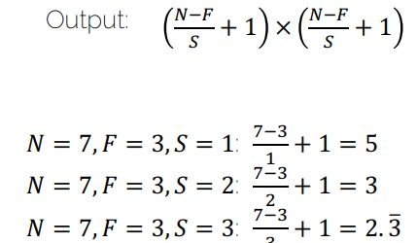

Convolution Layers: Dimensions
Input width of 𝑵
Input: Filter: Stride: Output:
𝑁×𝑁 F×𝐹
𝑆
 |  |  | ght
Filter | width of | 𝑭 | Filt
er hei of 𝑭
Input height of 𝑵
'#( _{+ 1 ×} '#( ₊ ₁
)
)
𝑁 = 7, 𝐹 = 3, 𝑆 = 1: "#$ + 1 = 5
%
𝑁 = 7, 𝐹 = 3, 𝑆 = 2: "#$ + 1 = 3
&
𝑁 = 7, 𝐹 = 3, 𝑆 = 3: "#$ + 1 = 2. 3<
$
Fractions are illegal
57

Slide 58
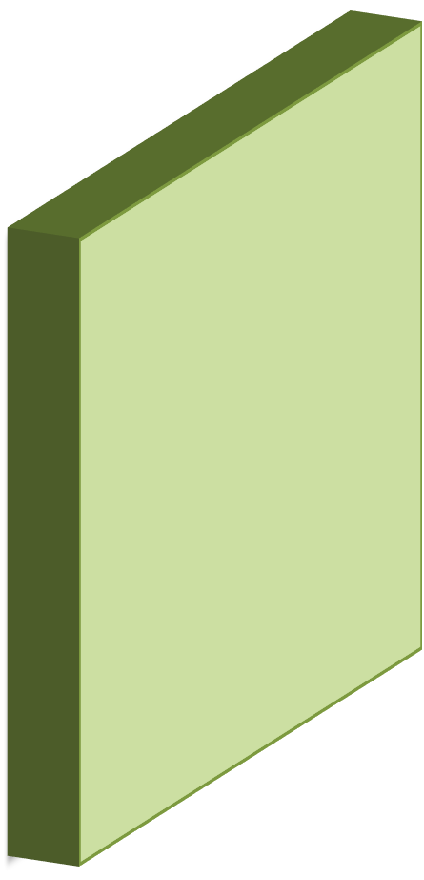
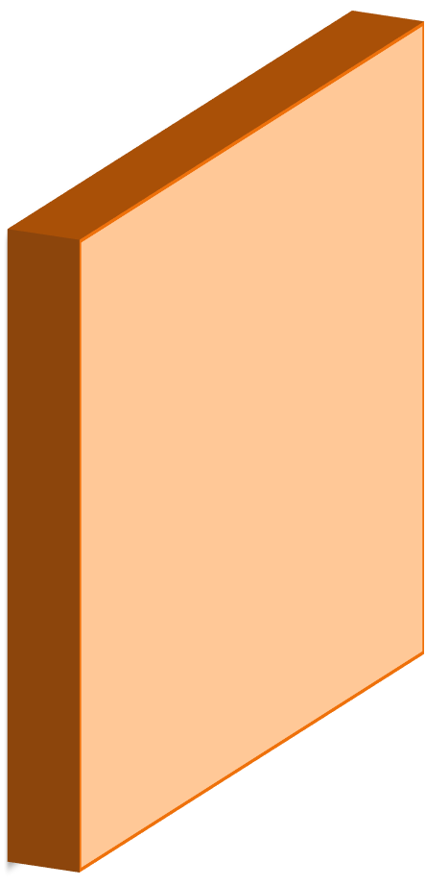
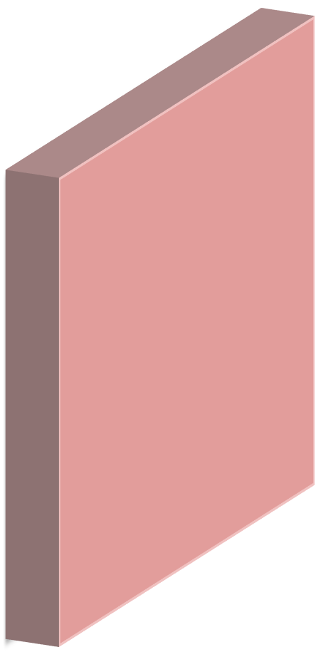
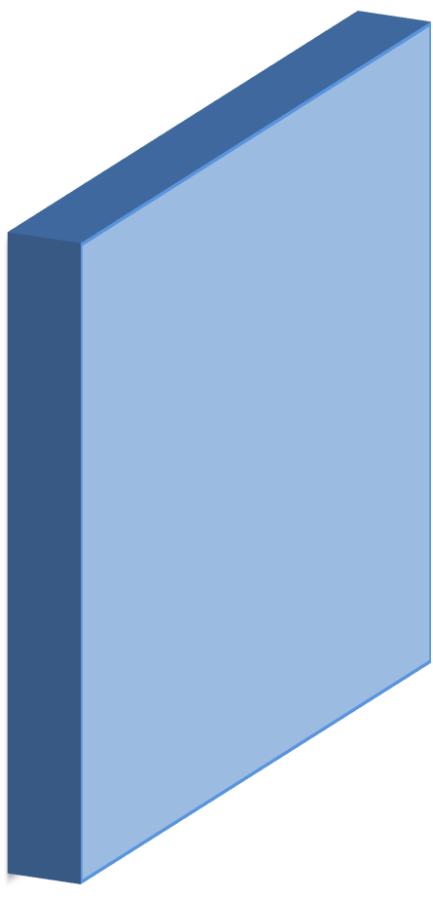



Convolution Layers: Dimensions
Input Image
Conv +
₃₂ ReLU
Conv +
28 ReLU
Conv +
²⁴ ReLU
 | 5 filters |  |  | 8 filters |  |  | 12 filters
32 | 5×5×3 | 5 | 28 | 5×5×5 | 8 | 24 | 5×5×8 | 12 | 20
3
Shrinking down so quickly (32→28→24→20) is typically not a good idea…
58

Slide 59
Convolution Layers: Padding
Why padding?
Sizes get small too quickly
Corner pixel is only used once
59

Slide 60
Convolution Layers: Padding
0 | 0 | 0 | 0 | 0 | 0 | 0 | 0 | 0
0 |  |  |  |  |  |  |  | 0
0 |  |  |  |  |  |  |  | 0
0 |  |  |  |  |  |  |  | 0
0 |  |  |  |  |  |  |  | 0
0 |  |  |  |  |  |  |  | 0
0 |  |  |  |  |  |  |  | 0
0 |  |  |  |  |  |  |  | 0
0 | 0 | 0 | 0 | 0 | 0 | 0 | 0 | 0
Why padding?
Sizes get small too quickly
Corner pixel is only used once
Image 7×7 + zero padding
60

Slide 61

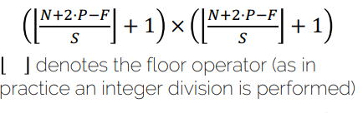
Convolution Layers: Padding
Input (𝑁×𝑁): 7×7
Filter (𝐹×𝐹): 3×3
Padding (𝑃): 1
Stride (𝑆): 1
Output 7×7
Most common is ‘zero’ padding Output Size:
0 | 0 | 0 | 0 | 0 | 0 | 0 | 0 | 0
0 |  |  |  |  |  |  |  | 0
0 |  |  |  |  |  |  |  | 0
0 |  |  |  |  |  |  |  | 0
0 |  |  |  |  |  |  |  | 0
0 |  |  |  |  |  |  |  | 0
0 |  |  |  |  |  |  |  | 0
0 |  |  |  |  |  |  |  | 0
0 | 0 | 0 | 0 | 0 | 0 | 0 | 0 | 0
Image 7×7 + zero padding
+ 1 × + 1
) )
denotes the floor operator (as in practice an integer division is performed)
61

Slide 62
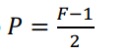
Convolution Layers: Padding
0 | 0 | 0 | 0 | 0 | 0 | 0 | 0 | 0
0 |  |  |  |  |  |  |  | 0
0 |  |  |  |  |  |  |  | 0
0 |  |  |  |  |  |  |  | 0
0 |  |  |  |  |  |  |  | 0
0 |  |  |  |  |  |  |  | 0
0 |  |  |  |  |  |  |  | 0
0 |  |  |  |  |  |  |  | 0
0 | 0 | 0 | 0 | 0 | 0 | 0 | 0 | 0
Types of convolutions:
Valid convolution: using no padding
Same convolution: output=input size
Image 7×7 + zero padding
Set padding to 𝑃 = ^{(#%}
&
62

Slide 63
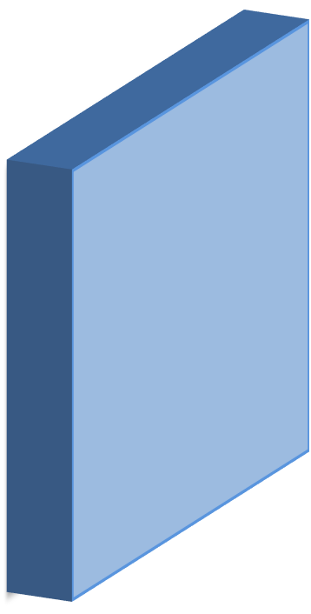
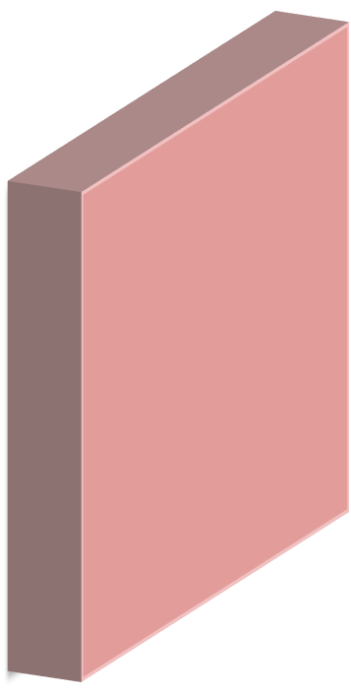


Convolution Layers: Dimensions
Example
32
Input image: 32×32×3
10 filters 5×5
Stride 1
Pad 2 Depth of 3 is implicitly given
10 Gilters
5×5×3
32
3
Output size is:
32 + 2 ⋅ 2 − 5 ₊ ₁ ₌ ₃₂
Remember
1
Output:
'*&⋅,#(
+ 1 ×
'*&⋅,#(
+ 1
i.e. 32×32×10
)
)
63

Slide 64
















Convolution Layers: Dimensions
Example
32
Input image: 32×32×3
10 filters 5×5
Stride 1
Pad 2
10 Gilters
5×5×3
32
3
Output size is:
32 + 2 ⋅ 2 − 5 ₊ ₁ ₌ ₃₂
Remember
1
Output:
'*&⋅,#(
+ 1 ×
'*&⋅,#(
+ 1
i.e. 32×32×10
)
)
64

Slide 65











Convolution Layers: Dimensions
Example
32
Input image: 32×32×3
10 filters 5 × 5
Stride 1
Pad 2
10 Gilters
5×5×3
32
3
Number of parameters (weights):
Each filter has 5 × 5 × 3 + 1 = 76 params (+1 for bias)
-> 76 ⋅ 10 = 760 parameters in layer
65

Slide 66
Convolutional Neural Network
(CNN)
66

Slide 67






CNN Prototype
ConvNet is concatenation of Conv Layers and activations
Input Image
Conv +
₃₂ ReLU
Conv +
28 ReLU
Conv +
²⁴ ReLU
 |  | 5 filters |  |  | 8 filters |  |  | 12 filters
3 | 32 | 5×5×3 | 5 | 28 | 5×5×5 | 8 | 24 | 5×5×8 | 12 | 20
67

Slide 68
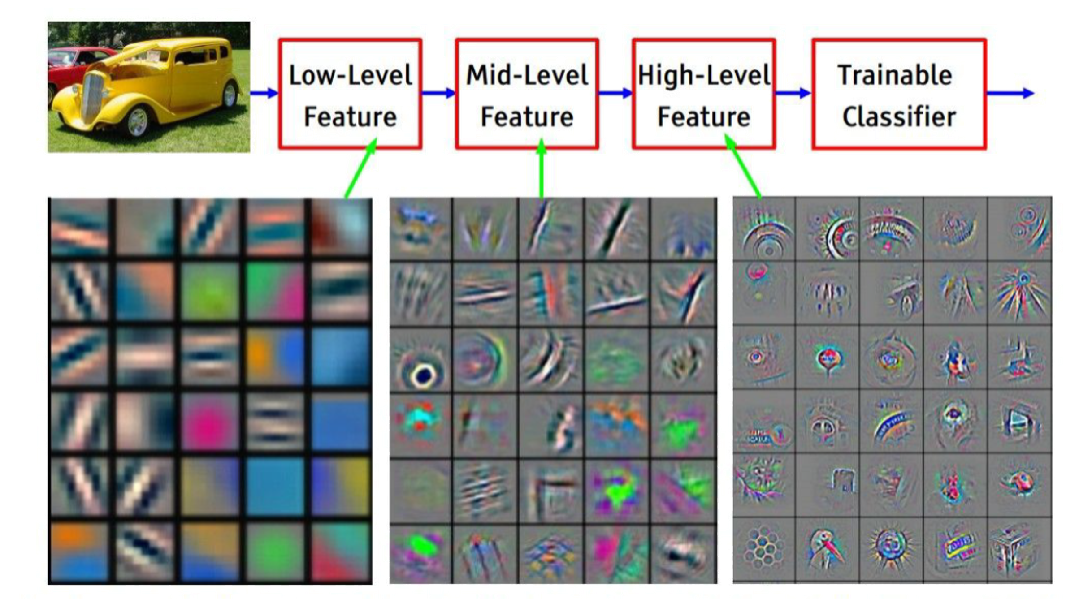
CNN Learned Filters
[Zeiler & Fergus, ECCV’14] Visualizing and Understanding Convolutional Networks
68

Slide 69
Pooling
69

Slide 70
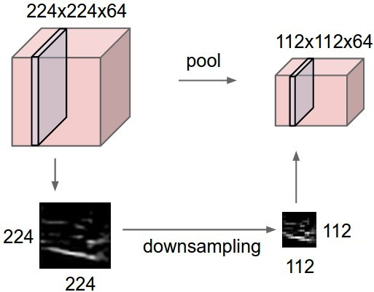
Pooling Layer
[Li et al., CS231n Course Slides] Lecture 5: Convolutional Neural Networks
70

Slide 71

Pooling Layer: Max Pooling
Single depth slice of input
3 | 1 | 3 | 5
6 | 0 | 7 | 9
3 | 2 | 1 | 4
0 | 2 | 4 | 3
‘Pooled’ output
Max pool with
2×2 filters and stride 2
6 | 9
3 | 4
71

Slide 72
Pooling Layer
Conv Layer = ‘Feature Extraction’
Computes a feature in a given region
Pooling Layer = ‘Feature Selection’
Picks the strongest activation in a region
72

Slide 73
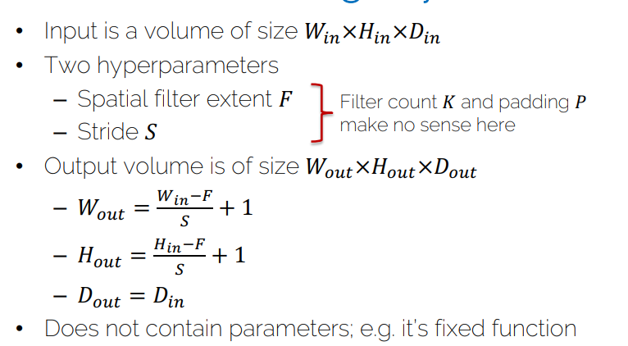

Pooling Layer
Input is a volume of size 𝑊!"×𝐻!"×𝐷!"
Two hyperparameters
Spatial filter extent 𝐹
Stride 𝑆
Filter count 𝐾 and padding 𝑃
make no sense here
Output volume is of size 𝑊#$%×𝐻#$%×𝐷#$%
– 𝑊#$% = ^{&%&'(} + 1
)
– 𝐻#$% = ^{*%&'(} + 1
)
^{– 𝐷}#$% ^{= 𝐷}!"
Does not contain parameters; e.g. it’s fixed function
73

Slide 74
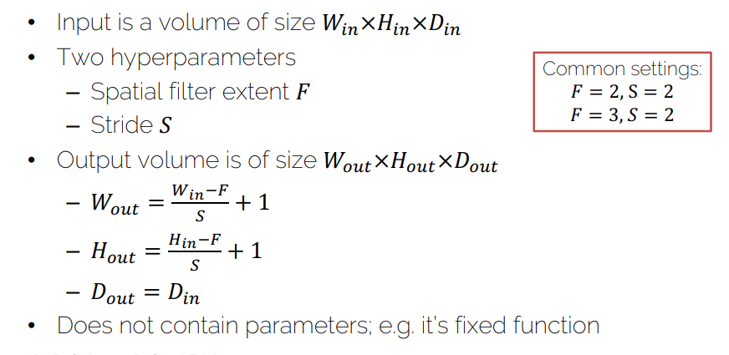
Pooling Layer
Input is a volume of size 𝑊!"×𝐻!"×𝐷!"
Two hyperparameters
Spatial filter extent 𝐹
Stride 𝑆
Output volume is of size 𝑊#$%×𝐻#$%×𝐷#$%
Common settings:
𝐹 = 2, S = 2
𝐹 = 3, 𝑆 = 2
– 𝑊#$% = ^{&%&'(} + 1
)
– 𝐻#$% = ^{*%&'(} + 1
)
^{– 𝐷}#$% ^{= 𝐷}!"
Does not contain parameters; e.g. it’s fixed function
74

Slide 75
Pooling Layer: Average Pooling
Single depth slice of input
3 | 1 | 3 | 5
6 | 0 | 7 | 9
3 | 2 | 1 | 4
0 | 2 | 4 | 3
‘Pooled’ output
Average pool with
2×2 filters and stride 2
2.5 | 6
1.75 | 3
Typically used deeper in the network
75

Slide 76

CNN Prototype
[Li et al., CS231n Course Slides]
Lecture 5: Convolutional Neural Networks
76

Slide 77
Final Fully-Connected Layer
Same as what we had in ‘ordinary’ neural networks
Make the final decision with the extracted features from the convolutions
One or two FC layers typically
77

Slide 78
Convolutions vs Fully-Connected
In contrast to fully-connected layers, we want to restrict the degrees of freedom
FC is somewhat brute force
Convolutions are structured
Sliding window to with the same filter parameters to extract image features
Concept of weight sharing
Extract same features independent of location
78

Slide 79

Receptive field
82

Slide 80
Receptive Field
Spatial extent of the connectivity of a convolutional filter
=
3x3 filter
3x3 output
5x5 input
80

Slide 81
Receptive Field
Spatial extent of the connectivity of a convolutional filter
=
3x3 filter
3x3 output
5x5 input
3x3 receptive field = 1 output pixel is connected to 9 input pixels
81

Slide 82

Receptive Field
Spatial extent of the connectivity of a convolutional filter
3x3 output
3x3 receptive field = 1 output pixel is connected to 9 input pixels
7x7 input
82

Slide 83

Receptive Field
Spatial extent of the connectivity of a convolutional filter
3x3 output
3x3 receptive field = 1 output pixel is connected to 9 input pixels
7x7 input
83

Slide 84
Receptive Field
Spatial extent of the connectivity of a convolutional filter
3x3 output
3x3 receptive field = 1 output pixel is connected to 9 input pixels
7x7 input
84

Slide 85

Receptive Field
Spatial extent of the connectivity of a convolutional filter
3x3 output
5x5 receptive field on the original input:
7x7 input
one output value is connected to 25 input pixels
85

Slide 86
Hands-on
https://colab.research.google.com/github/tensorflow/docs/blob/master/site/en/tutorials/keras/classification.ipynb#scrollTo=2tRmdq_8CaXb

Slide 87
Example
You are given a convolutional layer with 4 filters, kernel size 5, stride 1, and no padding that operates on an RGB image.
Q1: What are the dimensions and the shape of its weight tensor?
A1: (3, 4, 5, 5)
A2: (4, 5, 5)
A3: depends on the width and height of the image
87

Slide 88




Example
You are given a convolutional layer with 4 filters, kernel size 5, stride 1, and no padding that operates on an RGB image.
Q1: What are the dimensions and the shape of its
weight tensor?
A1: (3, 4, 5, 5)
Filter size = 5×5
Output size =
4 filters
Input channels (RGB = 3)
88

Slide 89
Example
You are given a convolutional layer with 4 filters, kernel size 5, stride 1, and no padding that operates on an RGB image.
Q1: What are the dimensions and the shape of its
weight tensor?
A1: (3, 4, 5, 5)
A2: (4, 5, 5)
A3: depends on the width and height of the image
89

